Slide 1
UNIT-VII Generics and Collections

Slide 2
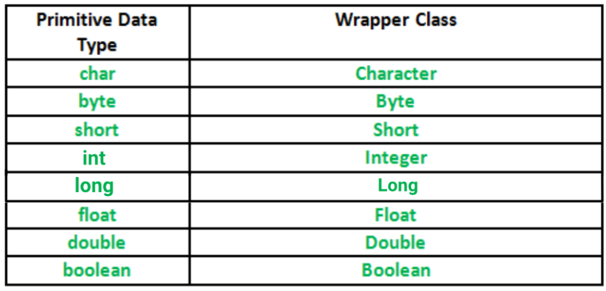
Wrapper Classes

Slide 3
Generics
Introduction
Introduced in jdk 5
It is way to parameterize the types (int,float,String,Object)
Possible to create classes,interfaces and methods which works with different types of data
A class,interface ,methods that uses parameterized types called a Generics
Generic class
Generic methods

Slide 4
Before generics ,generic classes and methods uses Object reference because Object is the super class for classes in java
Not full type safe
But Generics provide type safety
Many algorithms are logically the same no matter what type of data they are being applied to

Slide 5
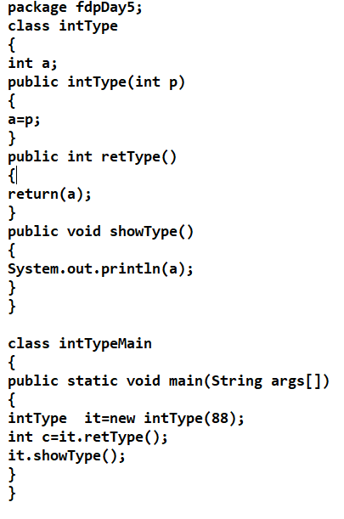
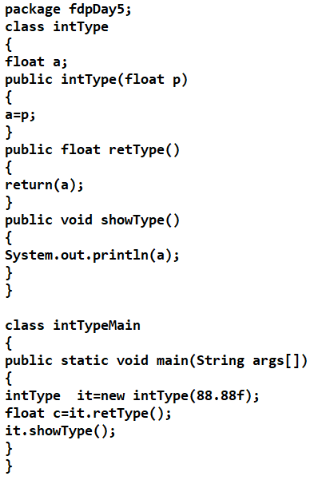
Example:Generic Class

Slide 6
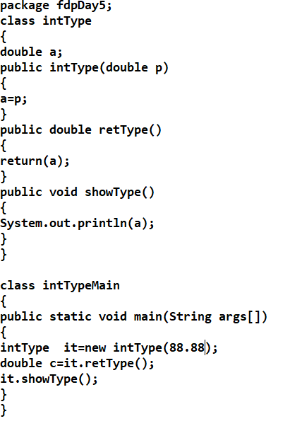
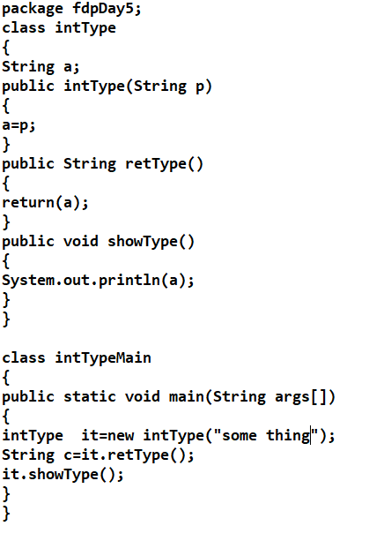

Slide 7
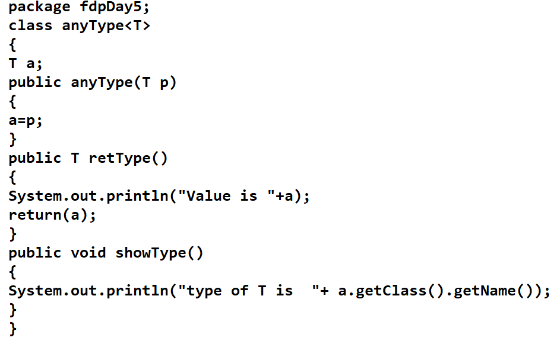
Using Generic Class

Slide 8
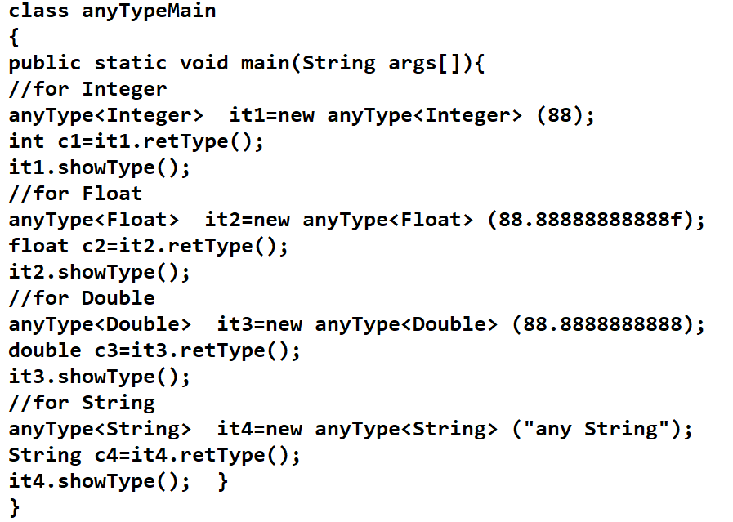

Slide 9
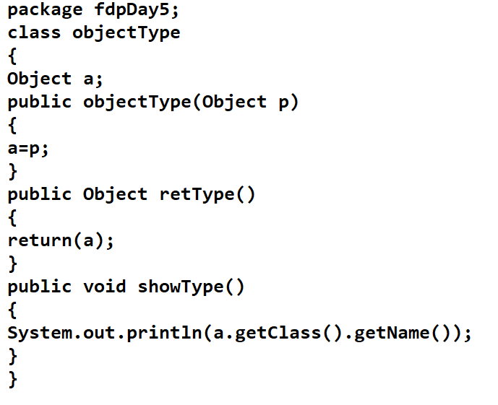
Pre-Generic using Object reference

Slide 10
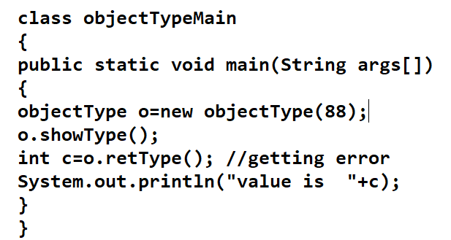
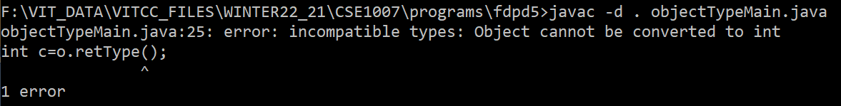

Slide 11
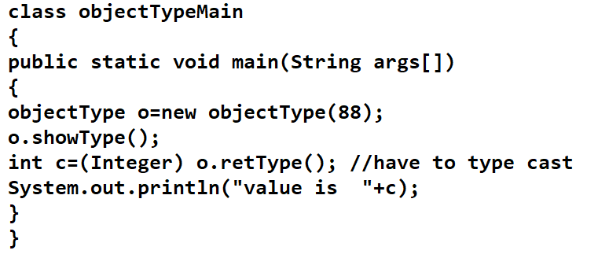

Slide 12
Bounded Types (restricting to some types)
In the previous examples any type can be fit
Like Integer,Float,Double and String
If to restrict the String type by allowing Integer,Float,Double
Bounding to Number Type
Integer,Float,Double are subclasses of Number class

Slide 13
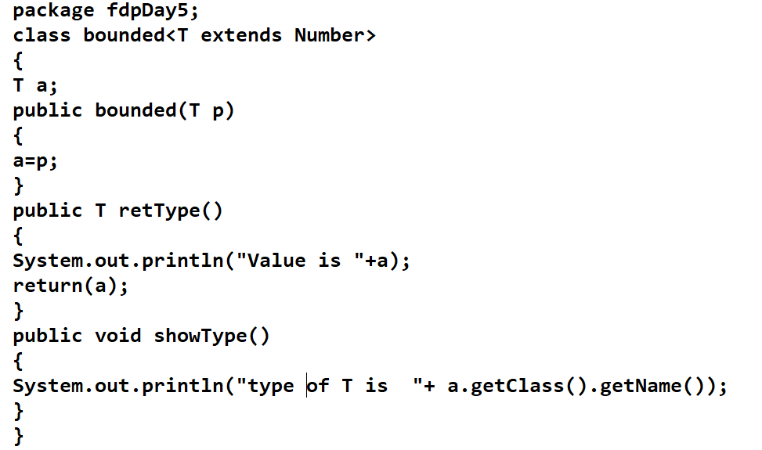

Slide 14
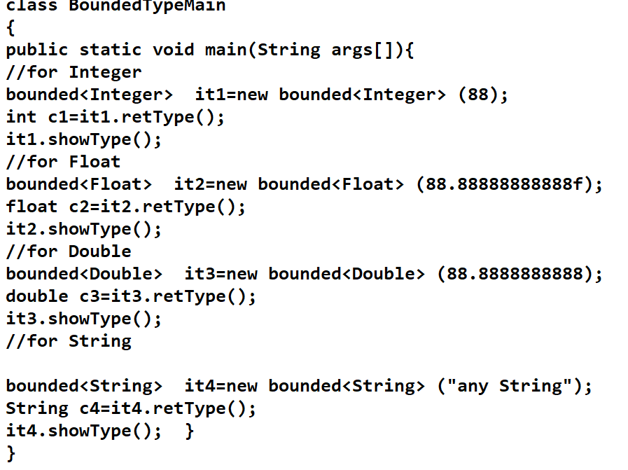

Slide 15
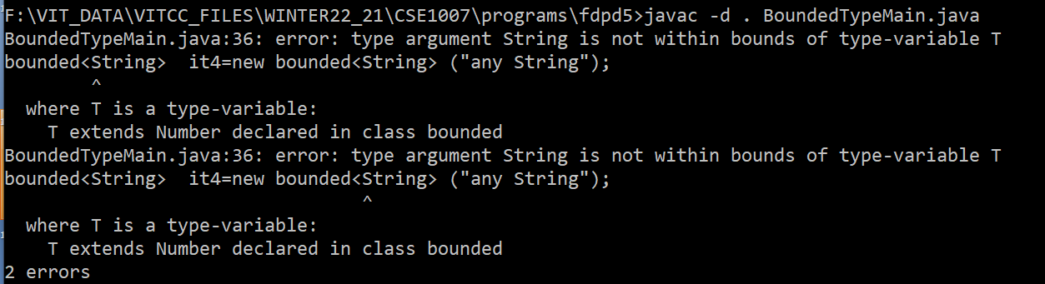
Error while using String

Slide 16
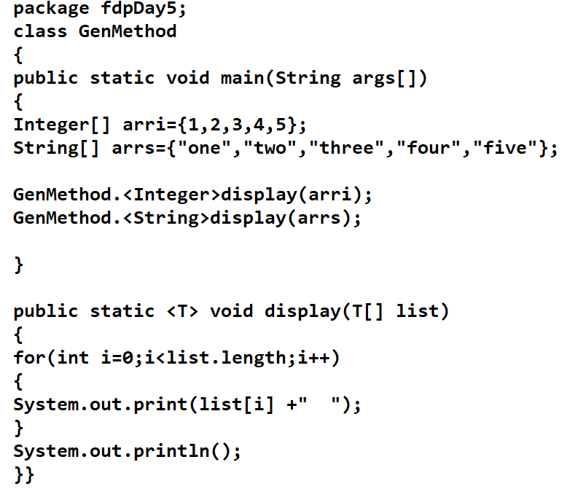
Example :Generic Method

Slide 17
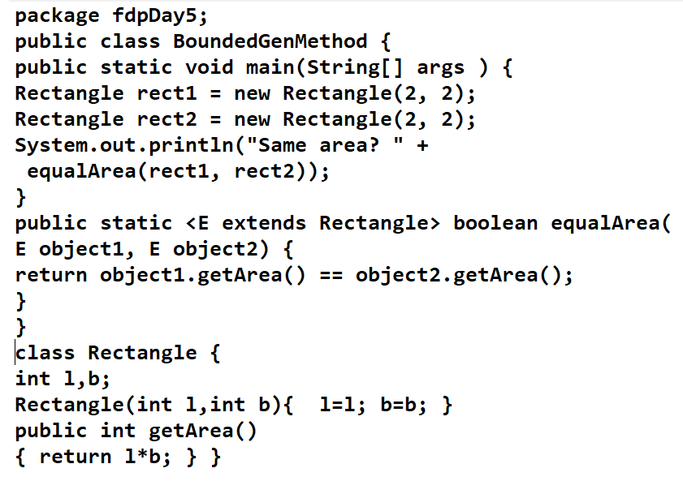
Bounded Generic Methods

Slide 18
Collections Framework
Java.util

Slide 19
Collections Frameworks
Provides interfaces and classes that provide state-of-the-art technology for managing groups of objects
Group of objects- dynamic arrays, linked lists, trees, and hash tables
Easy to handle group of objects
Pre-collections, java provided classes such as Vector, Dictionary, Stack and Properties

Slide 20
Parts of Collections
LinkedList, HashSet, and TreeSet
Algorithms

Slide 21
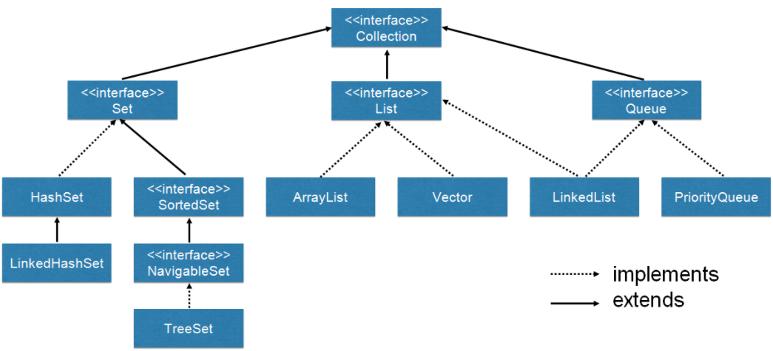
Collection Interface
Collection extends the Iterable interface
Courtesy : https://marcus-biel.com/wp-content/uploads/2015/08/class-and-interface-hierarchy.png

Slide 22
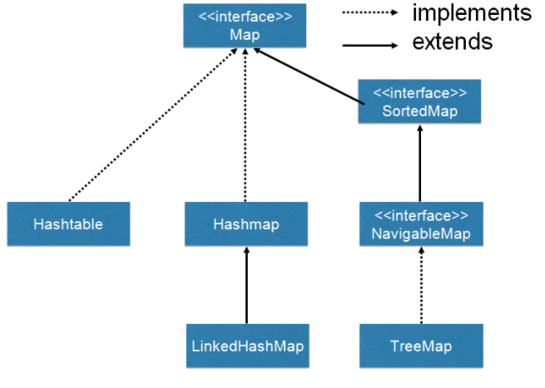
MAP Interface

Slide 23
Exception it throws
UnsupportedOperationException
NullPointerException
ClassCastException

Slide 24
Collection Classes
ArrayList Class
LinkedList Class
Hash Class

Slide 25
ArrayList
extends AbstractList and implements the List interface
supports dynamic arrays, dynamically increase or decrease in size
Constructors:
ArrayList( )
ArrayList(Collection<? extends E> c)
ArrayList(int capacity)

Slide 26
package fdpDay5;
import java.util.*;
class arrList
{
public static void main(String args[])
{
ArrayList<String> al=new ArrayList<String>();
System.out.println("initial size is "+al.size());
al.add("one");
al.add("two");
al.add("three");
al.add("four");
System.out.println(" size is "+al.size());
System.out.println("display the contents\n"+al);
}
}

Slide 27
LinkedList Class & methods
extends AbstractSequentialList and implements the List, Deque, and Queue interfaces
addFirst( ) or offerFirst( )
addLast( ) or offerLast( )
getFirst( ) or peekFirst( )
getLast( ) or peekLast( )
removeFirst( ) or pollFirst( )
removeLast( ) or pollLast()
remove()
get(i) -> returns value at given index
set(i,new_value)->updates the index i value by new_value

Slide 28
package fdpDay5;
import java.util.*;
class linkList
{
public static void main(String args[])
{
LinkedList<Integer> ll=new LinkedList<Integer>();
ll.add(11);
ll.add(12);
ll.add(13);
ll.offer(14);
System.out.println(ll);
ll.addFirst(10);
ll.addLast(15);
System.out.println(ll);
ll.add(4,20);
System.out.println(ll);
} }

Slide 29
Iterator Interface
enables you to move through a collection, obtaining or removing elements
Methods
hasNext()
next()
remove()
add()
Previous()
previousIndex()
nextIndex()
set()

Slide 30
package fdpDay5;
import java.util.*;
class arrList
{
public static void main(String args[])
{
ArrayList<String> al=new ArrayList<String>();
System.out.println("initial size is "+al.size());
al.add("one");
al.add("two");
al.add("three");
al.add("four");
System.out.println(" size is "+al.size());
System.out.println("display the contents\n"+al);
// using iterator iterface
System.out.println("using iterator iterface");
Iterator<String> ia=al.iterator();
while(ia.hasNext())
{
System.out.println(ia.next());
} } }

Slide 31
MAP Interface
maps unique keys to values
interface Map<K, V>
K specifies the type of keys, and V specifies the type of values
A key is used to retrieve a value
Two basic operations in maps
To put a value into a map -> put()
To get a value from a map ->get()
Classes : HashMap,TreeMap,LinkedListMap,AbstractMap..etc

Slide 32
Example HashMap
package fdpDay5;
import java.util.*;
public class hashMapExample
{
public static void main(String args[])
{
HashMap<Integer,String> hm=new HashMap<Integer,String>();
hm.put(1,"Mumbai");
hm.put(2,"Delhi");
hm.put(3,"Chennai");
hm.put(4,"Banglore");
System.out.println(hm.get(1));
}
}

Slide 33
Map.Entry Interface
to work with a map entry
returns a Set containing the map entries
getKey()
getValue()
equals()
setValue(v)

Slide 34
package fdpDay5;
import java.util.*;
public class hashMapExample
{
public static void main(String args[])
{
HashMap<Integer,String> hm=new HashMap<Integer,String>();
hm.put(1,"Mumbai");
hm.put(2,"Delhi");
hm.put(3,"Chennai");
hm.put(4,"Banglore");
Set<Map.Entry<Integer,String>> ss=hm.entrySet();
for(Map.Entry<Integer,String> i : ss)
{
System.out.println(i.getKey() +" : "+ i.getValue());
}
}
}

Slide 35
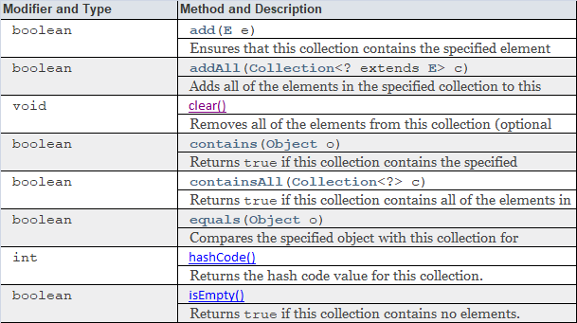
Methods Defined in

Slide 36
